Slide 1

Introduction to IT Project Management and Entrepreneurship
Lecture 1
Deepak Chandra Roy
Adjunct Faculty, CSE, EWU
deepak.kth@gmail.com
01685441156

Slide 2
Agenda
Overview of Today's Class
Introduction to the Course
Key Concepts
Learning Objectives
Overview of IT Project Management and Entrepreneurship
Next Class >> Project Initiation

Slide 3
Course Structure
Structure
Marks Distribution
Theory, tools, brainstorming session with case study, assignment, project
Contents: Key components of project management & Entrepreneurship, IT Project management steps, processes and methodologies etc.
Midterm: 25
Final: 25
Quiz: 10
Assignment: 20
Mini project: 10
Case study: 10

Slide 4
Learning Objectives
The specific objectives students will achieve by the end of today's class:
Understand the course's scope and objectives
Comprehend the importance of IT in entrepreneurship

Slide 5

Textbook and Resources
Will be mentioned necessary resources if required

Slide 6
Importance of the Course
Why is this course relevant
IT in Entrepreneurship
Career Opportunities
Real-world examples

Slide 7
Why the course is relevant?
Integration of Technology: In today's business landscape, technology is integral to almost every industry. Entrepreneurs need to understand how to leverage IT solutions to innovate, streamline operations, and create a competitive edge.
Efficient Resource Management: IT project management helps entrepreneurs effectively manage resources, including time, budget, and human capital, leading to more efficient project execution and cost control.
Risk Mitigation: Entrepreneurial ventures often involve significant risks. Learning IT project management allows entrepreneurs to identify, assess, and mitigate project risks effectively, increasing the likelihood of success.
Effective Collaboration: IT project management emphasizes collaboration and communication among team members, stakeholders, and partners. Entrepreneurs can use these skills to build strong teams and foster productive relationships.

Slide 8
Why the course is relevant? Cont..
Strategic Decision-Making: Entrepreneurs make critical decisions daily. Understanding project management principles equips them with structured approaches to decision-making based on data and analysis.
Resource Optimization: Entrepreneurs often operate with limited resources. IT project management helps in optimizing resource allocation, ensuring that each resource is used efficiently.
Customer-Centric Approach: IT project management methodologies, such as Agile, prioritize customer feedback and satisfaction. Entrepreneurs can use these methods to create products and services that better meet customer needs.
Scaling Opportunities: As startups grow, they often face challenges related to scaling. Project management knowledge is crucial for managing expansion, whether it's scaling operations, technology infrastructure, or product offerings.

Slide 9
Why the course is relevant? Cont..
Stakeholder Management: Entrepreneurs interact with various stakeholders, including investors, customers, and partners. Project management skills assist in managing these relationships, ensuring that all parties' expectations are met.
Competitive Advantage: Entrepreneurs who understand IT project management are better positioned to innovate faster and stay ahead of competitors, especially in technology-driven industries.
Globalization: In a globalized economy, entrepreneurs may work with teams and partners from different parts of the world. IT project management methodologies support remote collaboration and effective communication across borders.
Entrepreneurial Success: Successful entrepreneurs must effectively execute projects, whether it's launching a new product, expanding into new markets, or implementing strategic initiatives. IT project management contributes to these successes.

Slide 10
Career Opportunities
Project Management Professional (PMP)
Certified Associate in Project Management (CAPM)
Certified ScrumMaster (CSM)
Certified Information Systems Security Professional (CISSP)
Certified Information Security Manager (CISM)
CompTIA Project+
More..
Resources: https://www.linkedin.com/pulse/15-best-project-management-certifications-/

Slide 11
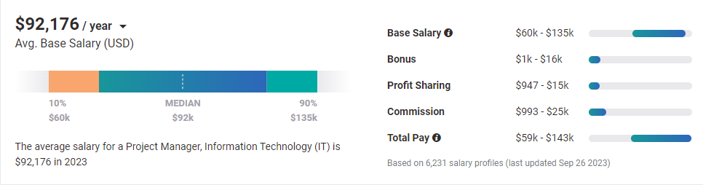
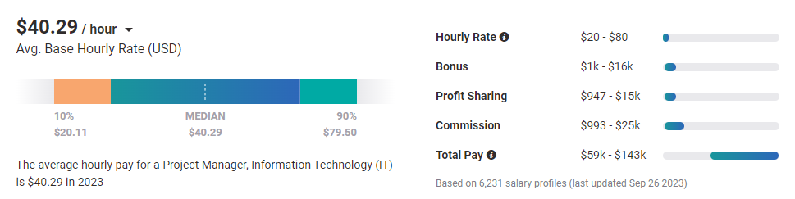
Average Salary Range
Source: https://www.payscale.com/research/US/Job=Project_Manager%2C_Information_Technology_(IT)/Salary

Slide 12
IT Project Management & Entrepreneurship
IT + Project Management + Entrepreneurship
Technologies to manage and process information efficiently
process of identifying, creating, and pursuing opportunities to start and manage a new business or initiative
Process of completing a project within time, budget & resources without compromising the quality.

Slide 13
Information Technology
Information technology (IT) is the use of computer systems or devices to access information. Information technology is responsible for such a large portion of our workforce, business operations and personal access to information that it comprises much of our daily activities. Whether you are storing, retrieving, accessing or manipulating information, IT greatly impacts our everyday lives.
https://www.comptia.org/content/articles/what-is-information-technology

Slide 14
Project Management
Define Project:
A project is a temporary endeavor (it has a start and end date), undertaken to create a unique product, service or result within defined constraints. A project concludes when its specific tangible and/or intangible objectives have been attained and its resources have been released to do other work.
A unique endeavor (not repeated)
Temporary, with a distinct beginning and end
Defined by specific deliverables
Conducted by a temporary team that exists for the duration of its execution
Having a project manager who is responsible for its success
Defined by identifying its starting point, the goals/objectives, and the route between them
Source: https://www.umb.edu/it/about/project-management-office/definition-of-a-project/

Slide 15
Project Management cont..
Define Project:
Project should be SMART
S = Specific
M = Measurable
A = Achievable
R = Realistic
T = Time-bound
T: A project should have a defined timeline with specific deadlines for completing various milestones and the overall project. Time-bound goals create a sense of urgency and help with project planning and scheduling. They also ensure that the project stays on track and doesn't drag on indefinitely.
R: The project's objectives should be relevant and aligned with the broader goals and strategic priorities of the organization. A relevant project contributes to the organization's mission and addresses a genuine need or problem. It should make sense in the context of the organization's overall strategy.
A: The goals and objectives set for the project should be attainable and realistic. This involves considering the available resources, budget, time constraints, and technical feasibility. An achievable project ensures that it's possible to reach the desired outcomes within the given constraints.
M:A project should have measurable criteria to determine its progress and success. This involves defining key performance indicators (KPIs) or metrics that can be used to track and quantify the project's outcomes. Measurable objectives allow stakeholders to assess whether the project is meeting its goals.
S: The project's objectives and goals should be clear and specific. This means defining what needs to be achieved, why it's important, who is involved, where it will take place, and what resources are required. A specific project statement helps avoid ambiguity and ensures everyone understands the project's purpose.

Slide 16
Project Management cont..
SMART framework to define project :
By defining a project using the SMART criteria, you create a clear and focused roadmap for project planning and execution. It helps ensure that the project is well-defined, feasible, and aligned with organizational goals, increasing the likelihood of successful outcomes.
Project Name: Implementing a Customer Relationship Management (CRM) System
T: The project will be completed within six months, with specific milestones and deadlines for each phase, including software selection, customization, training, and rollout.
R: The CRM project aligns with the organization's strategic goals of improving customer satisfaction and increasing sales efficiency. It addresses the need for better customer data management.
A: The project is achievable within the allocated budget and resources. The necessary software and hardware are available, and the project team has the required skills and expertise.
M: Measure project success based on the following metrics: a 20% increase in customer response time, a 15% increase in lead conversion rates, and a 10% reduction in manual data entry time.
S: Develop and implement a CRM system to improve customer relationship management for the sales and customer support teams. The system will centralize customer data, streamline communication, and automate certain processes. It will involve collaboration between the IT department, sales, and customer support teams.
Notes:
A "15% increase in lead conversion rates" is a specific and measurable goal commonly used in marketing and sales contexts. It means that the objective of a project or marketing campaign is to achieve a 15% improvement in the percentage of leads (potential customers) who take a desired action, typically becoming paying customers or clients.
Lead Conversion Rate: This refers to the percentage of leads who complete a specific action that indicates their interest or intent to make a purchase. In many cases, it involves converting leads into paying customers. The lead conversion rate is calculated as follows:
Lead Conversion Rate=(Number of Conversions Total Number of Leads)×100Lead Conversion Rate=(Total Number of LeadsNumber of Conversions​)×100
Number of Conversions: The number of leads who took the desired action (e.g., made a purchase, signed up for a service, requested more information).
Total Number of Leads: The initial pool of leads or potential customers.
Eg: CRM of Sheba.xyz, you were not intended to take a service, but by involvment into the CRM Process you ordered some service.

Slide 17
Project Management cont..
What is Management?
It is a set of activities and tasks undertaken by one or more persons for the purpose of planning & controlling the activities of others in order to achieve an objective or complete an activity that could not be achieved by others acting independently.
Koontz, H., C. O’Donnell and H. Weihirch, Management, 7th ed., McGraw-Hill, New York,N. Y., 1980

Slide 18
Project Management cont..
Components of Management:
Planning
Organizing
Staffing
Directing (Leading)
Controlling

Slide 19
Project Management cont..
Planning
Pre-determining course of action to achieve the objectives
Organizing
Establishing relationship among work units and granting responsibility and authority to obtain the objectives
Staffing
Selecting and training people
Directing (Leading)
Creating an atmosphere that will assist & motivate people to achieve the desired end results
Controlling
Establishing, measuring, and evaluating performance of activities towards planned objectives

Slide 20
Project Management cont..
Project Management?
It is the discipline of planning, organizing, and managing resources to bring about the successful completion of specific project goals and objectives

Slide 21
Project Management cont..
The application of knowledge, skills, tools, and techniques to project activities to meet the project requirement
Project management helps ensure success
The project management is the ability to administrator a series of tasks resulting in a desired goal

Slide 22
Project Management cont..
The Triple Constraint
Time
Cost
Scope

Slide 23
The Triple Constraint
Scope – sum of products and services to be provided as a project
Cost – means the money, labor, equipment, and other resources needed to complete the project
Time – refers to the schedule, or, in other words, how long it takes to complete the project
Notes:
In the context of entrepreneurship and business, the term "venture" often refers to a business or project that involves risk and uncertainty. A venture is typically a new or innovative business initiative that carries a degree of risk due to factors such as market competition, financial investments, and the potential for success or failure.
In entrepreneurship, the term "venture" refers to a business or startup initiative that involves taking risks in the pursuit of profit or other objectives. A venture typically involves launching a new business or investing in an innovative project with the expectation of achieving financial gains.
Ventures in entrepreneurship can take various forms, such as:
Startup Ventures: These are newly established businesses with innovative ideas or products. Startups often seek funding from investors or venture capitalists to grow and expand their operations.
Entrepreneurial Ventures: These are businesses initiated and managed by entrepreneurs who are willing to take calculated risks in pursuit of opportunities. These ventures can range from small sole proprietorships to larger corporations.
Social Ventures: Some ventures focus on addressing social or environmental issues while also aiming to generate profits. These social entrepreneurs seek to create positive impacts on society through their business activities.
Corporate Ventures: Established companies may also engage in ventures by launching new divisions or subsidiaries to explore new markets or innovative products. These ventures are often referred to as corporate entrepreneurship or "intrapreneurship."
In summary, a venture in entrepreneurship is a business endeavor characterized by its risk-taking nature and the pursuit of financial gains or other goals. Entrepreneurs play a vital role in identifying opportunities, taking calculated risks, and creating innovative solutions to drive the success of their ventures.

Slide 24
Entrepreneurship
Entrepreneurship is the process of creating, organizing, and managing a business or venture with the goal of taking financial risks in the pursuit of profit.
Entrepreneurs are individuals who identify opportunities in the market, develop innovative ideas or solutions, and then assemble the necessary resources, such as capital, labor, and technology to turn those ideas into reality.
Notes:
In the context of entrepreneurship and business, the term "venture" often refers to a business or project that involves risk and uncertainty. A venture is typically a new or innovative business initiative that carries a degree of risk due to factors such as market competition, financial investments, and the potential for success or failure.
In entrepreneurship, the term "venture" refers to a business or startup initiative that involves taking risks in the pursuit of profit or other objectives. A venture typically involves launching a new business or investing in an innovative project with the expectation of achieving financial gains.
Ventures in entrepreneurship can take various forms, such as:
Startup Ventures: These are newly established businesses with innovative ideas or products. Startups often seek funding from investors or venture capitalists to grow and expand their operations.
Entrepreneurial Ventures: These are businesses initiated and managed by entrepreneurs who are willing to take calculated risks in pursuit of opportunities. These ventures can range from small sole proprietorships to larger corporations.
Social Ventures: Some ventures focus on addressing social or environmental issues while also aiming to generate profits. These social entrepreneurs seek to create positive impacts on society through their business activities.
Corporate Ventures: Established companies may also engage in ventures by launching new divisions or subsidiaries to explore new markets or innovative products. These ventures are often referred to as corporate entrepreneurship or "intrapreneurship."
In summary, a venture in entrepreneurship is a business endeavor characterized by its risk-taking nature and the pursuit of financial gains or other goals. Entrepreneurs play a vital role in identifying opportunities, taking calculated risks, and creating innovative solutions to drive the success of their ventures.

Slide 25
Entrepreneurship cont..
Key aspects of entrepreneurship include:
Innovation: Entrepreneurs often introduce new products, services, or business models that can disrupt existing markets or create entirely new ones.
Risk-Taking: Entrepreneurship involves a willingness to take calculated risks, as success is not guaranteed, and there is a possibility of financial loss.
Resource Management: Entrepreneurs must effectively manage resources, including finances, time, and talent, to achieve their goals.
Independence: Entrepreneurs typically have a degree of independence and control over their business decisions, which can be a motivating factor for many.
Problem Solving: Entrepreneurship often involves identifying and solving problems or meeting unmet needs in the market.
Intrapreneurship: Entrepreneurial behavior can also be displayed within larger organizations, where employees develop and implement innovative ideas or projects, known as intrapreneurship.
Entrepreneurship plays a vital role in economic development by creating jobs, driving innovation, and fostering competition. It can take various forms, including small startups, family businesses, tech companies, and social enterprises, among others. Entrepreneurs come from diverse backgrounds and can be found in various industries, each contributing to the growth and dynamism of the economy.

Slide 26


Successful tech start-ups
Airbnb, Inc (Air Bed & Breakfast)
American San Francisco-based company
operating an online marketplace for short- and long-term home stays
The company acts as a broker and charges a commission from each booking
Founded in 2008
Airbnb has a market cap or net worth of $85.16 billion as of 5 October, 2023
Airbnb is the most well-known company for short-term housing rentals.

Slide 27

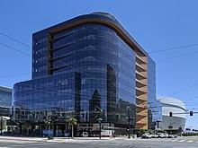
Successful tech start-ups cont..
Uber Technologies, Inc.
Ridesharing, food delivery, and transportation network company
The largest ridesharing company in the United States
Operates in approximately 70 countries and 10,500 cities worldwide
The company acts as a broker and charges a commission from each trip
Founded in 2009
Uber Technologies has a market cap or net worth of $89.65 billion as of October 5, 2023

Slide 28

Successful tech start-ups cont..
ShoupUp
Country’s largest full-stack B2B commerce platform for small and local businesses
It simplifies the lengthy logistic process by developing a B2B (business to business) platform that connects producers to wholesalers, wholesalers to retailers, and retailers to consumers.
Enabling small business via technology – mokam (B2B commerce platform), REDX (Logistic Service), Onkur (Financial Solution)
Founded in 2016

Slide 29

Successful tech start-ups cont..
Ten Minutes School
The largest digital educational platform
The purpose of Ten Minute School was to address some of the major challenges like accessing quality education while breaking the geological barrier
Partnered with Robi (Telecommunication Provide)
Founded in 2014
Reference: https://businessinspection.com.bd/most-promising-tech-startups-in-bangladesh/

Slide 30





Some other successful starts-up cont..

Slide 31
Interactive Discussion
Why do you think IT plays a crucial role in the success of entrepreneurial ventures?

Slide 32
Icebreaker/Interactive Activity
Group Formation

Slide 33
Homework/Assignment

Slide 34
Summary of Key Points
Recap the main concepts covered in today's class.
Course overview
Key Concepts
Information Technology
Project Management
Entrepreneurships
Role of IT in Entrepreneurships
Group formation
Assignment (Finding Project)

Slide 35

Questions and Discussion

